Slide 1

School of Computer Science
https://cs.uwindsor.ca
WINASSIST
FINAL PROJECT PRESENTATION
Master of Applied Computing
COMP - 8117 Advanced Software Engineering Topics
Submitted to : Dr. Usama Mir and Mr. Soroush Ziaeinejad

Slide 2

Content
WinAssist Team Roles and Responsibilities
WinAssist - Introduction
Scrum-Agile Methodology
Tools used in WinAssist
Use case model and WinAssist Demo
Future Scope and Summary
[1]

Slide 3
MEET THE WINASSIST TEAM
TEAM MEMBER | STUDENT ID | ROLES
Abinaya Elanchezhian | 110061220 | QA Team, RnD Team
Ashmi Mary Joseph | 110062708 | RnD Team, Dev Team
Faiza Iqbal | 110058873 | Design Team
Jatin Bindra | 110070076 | Dev Team
Mehardeep Singh | 110072529 | RnD Team, Dev Team
Pawan Shukla | 110063781 | RnD Team
Tanisha Chhabra | 110067902 | Design Team

Slide 4
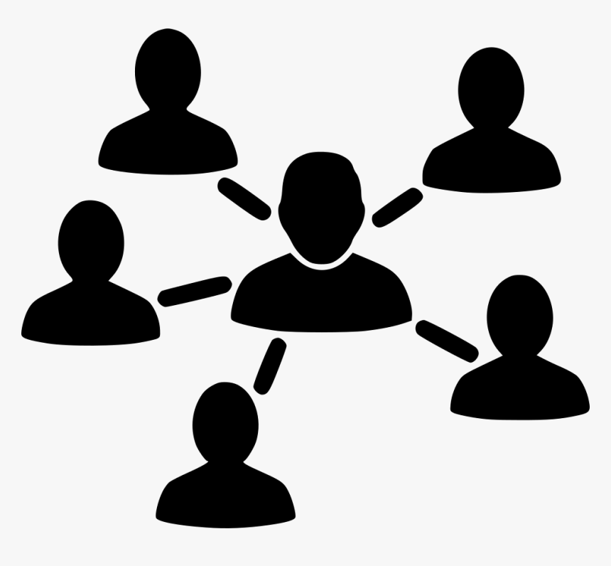
WINASSIST TEAM - ROLES AND RESPONSIBILITIES
RESEARCH AND DEVELOPMENT TEAM
Members - Pawan, Abinaya, Mehardeep, Ashmi
DESIGN TEAM Members - Faiza, Tanisha
DEVELOPMENT TEAM Members - Jatin, Mehardeep, Ashmi
QUALITY ASSURANCE TEAM Members - Abinaya
[2]

Slide 5

A BRIEF INTRODUCTION ABOUT WINASSIST
A Navigation app to help new people move around the city.
Assist people in Windsor to know the city better
Guiding new immigrants to complete their mandatory tasks such as SIN and GIC
A user friendly experience for everyone irrespective of an individual’s technical knowledge.

Slide 6
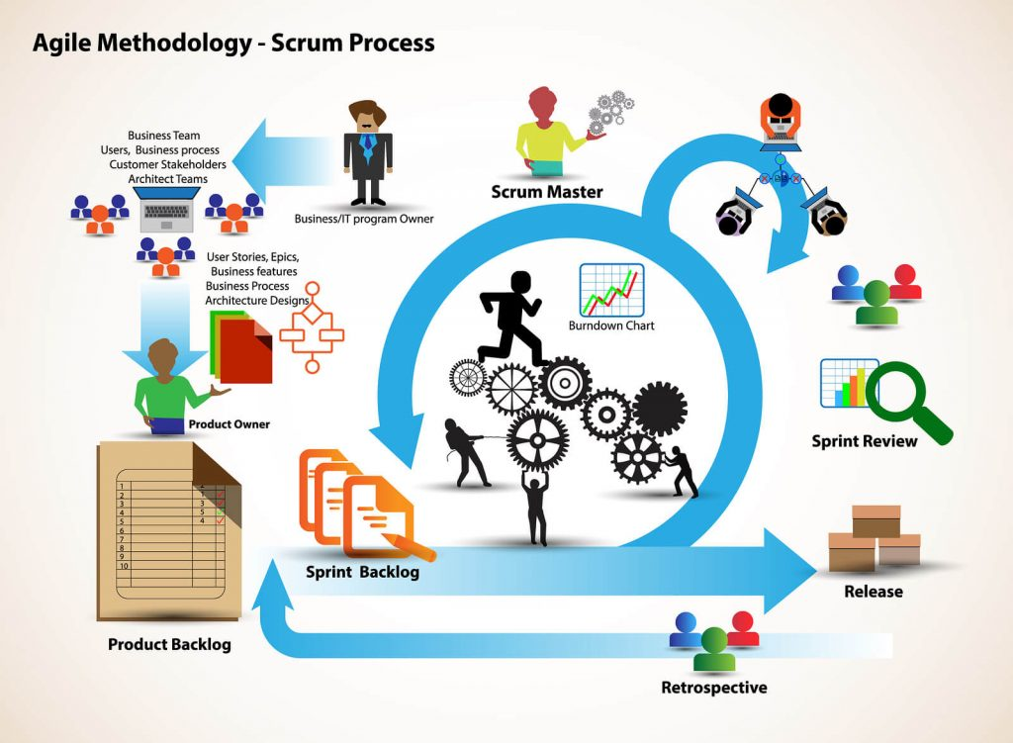
SCRUM - AGILE METHODOLOGY
Why SCRUM METHODOLOGY ?
Flexible to changes
Compliance to expectation
Easily scalable
WinAssist Team had Scrum call every Monday and Thursday of the week.
Each sprint in WinAssist is of two weeks
[3] Scrum Project Management

Slide 7

WINASSIST - SPRINT TIMELINES
WinAssist Sprint 1 : September 20, 2021 - October 3, 2021
WinAssist Sprint 2 : October 4, 2021 - October 9, 2021
WinAssist Sprint 3 : October 19, 2021 - October 29, 2021
WinAssist Sprint 4 : November 1, 2021 - November 12, 2021
WinAssist Sprint 5 : November 15, 2021 - November 26, 2021
[4]

Slide 8
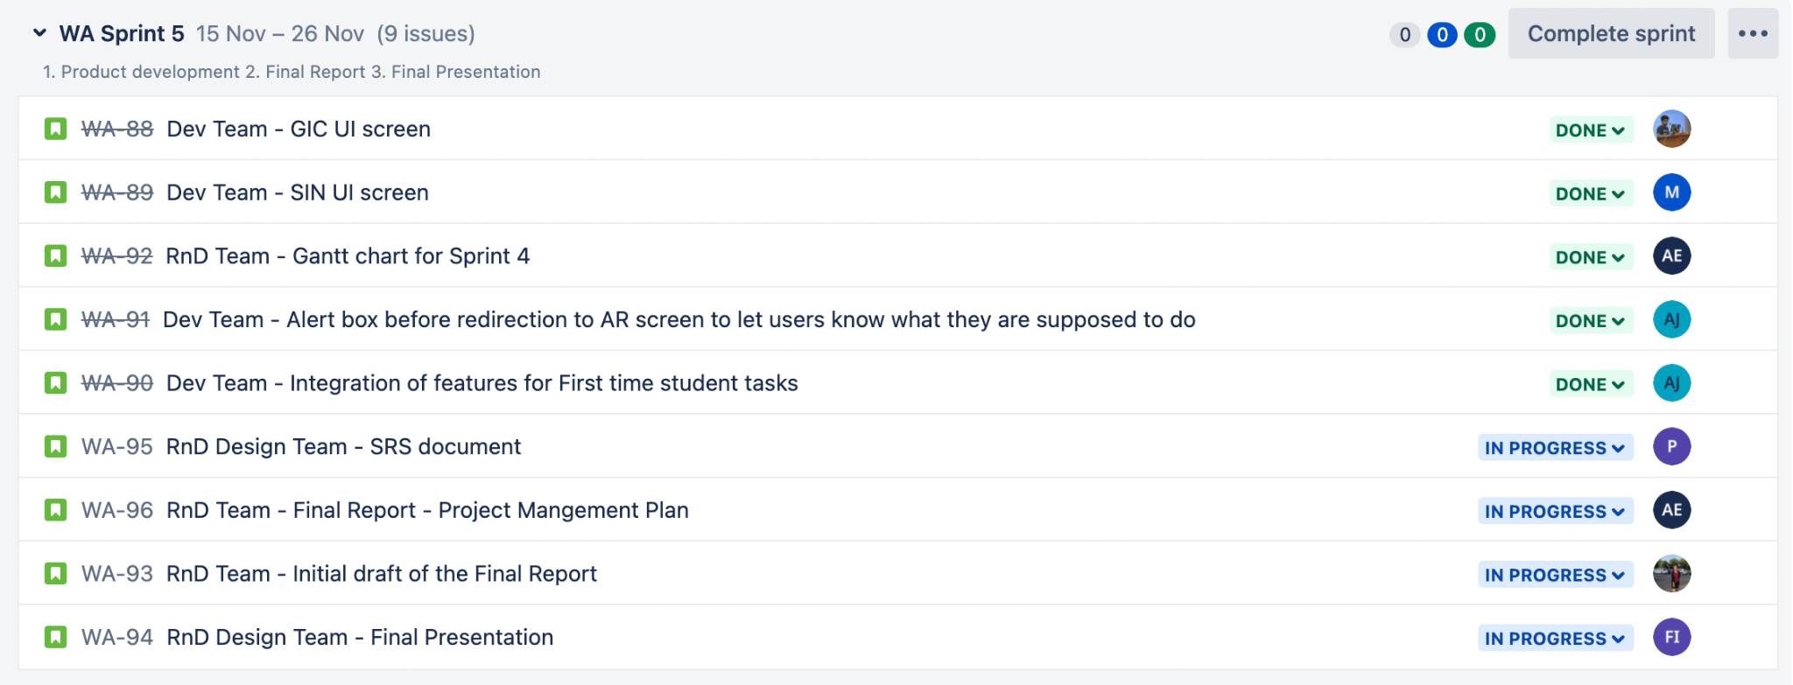
WINASSIST - Sprint 5 Tasks
Following are the set of individual tasks in JIRA Board for Sprint 5

Slide 9
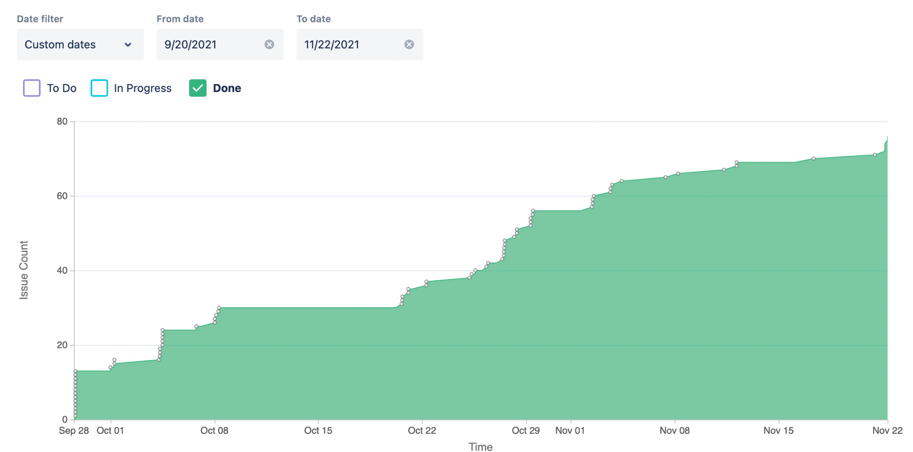
WINASSIST - Cumulative Flow Diagram
The Cumulative flow diagram shows the statuses of our project issues over time

Slide 10
WINASSIST: TOOLS USED
PURPOSE | TOOL
Prototype Designing | Figma
Frontend Framework | React JS
AR Library | AR.js
Documentation | Google Docx
Communication Channels | Microsoft Team, Outlook, WhatsApp
Project Version Control | GitHub
Project Management | JIRA Software
Gantt Chart Designing | Smartsheet
Use case diagram Designing | Lucidchart

Slide 11
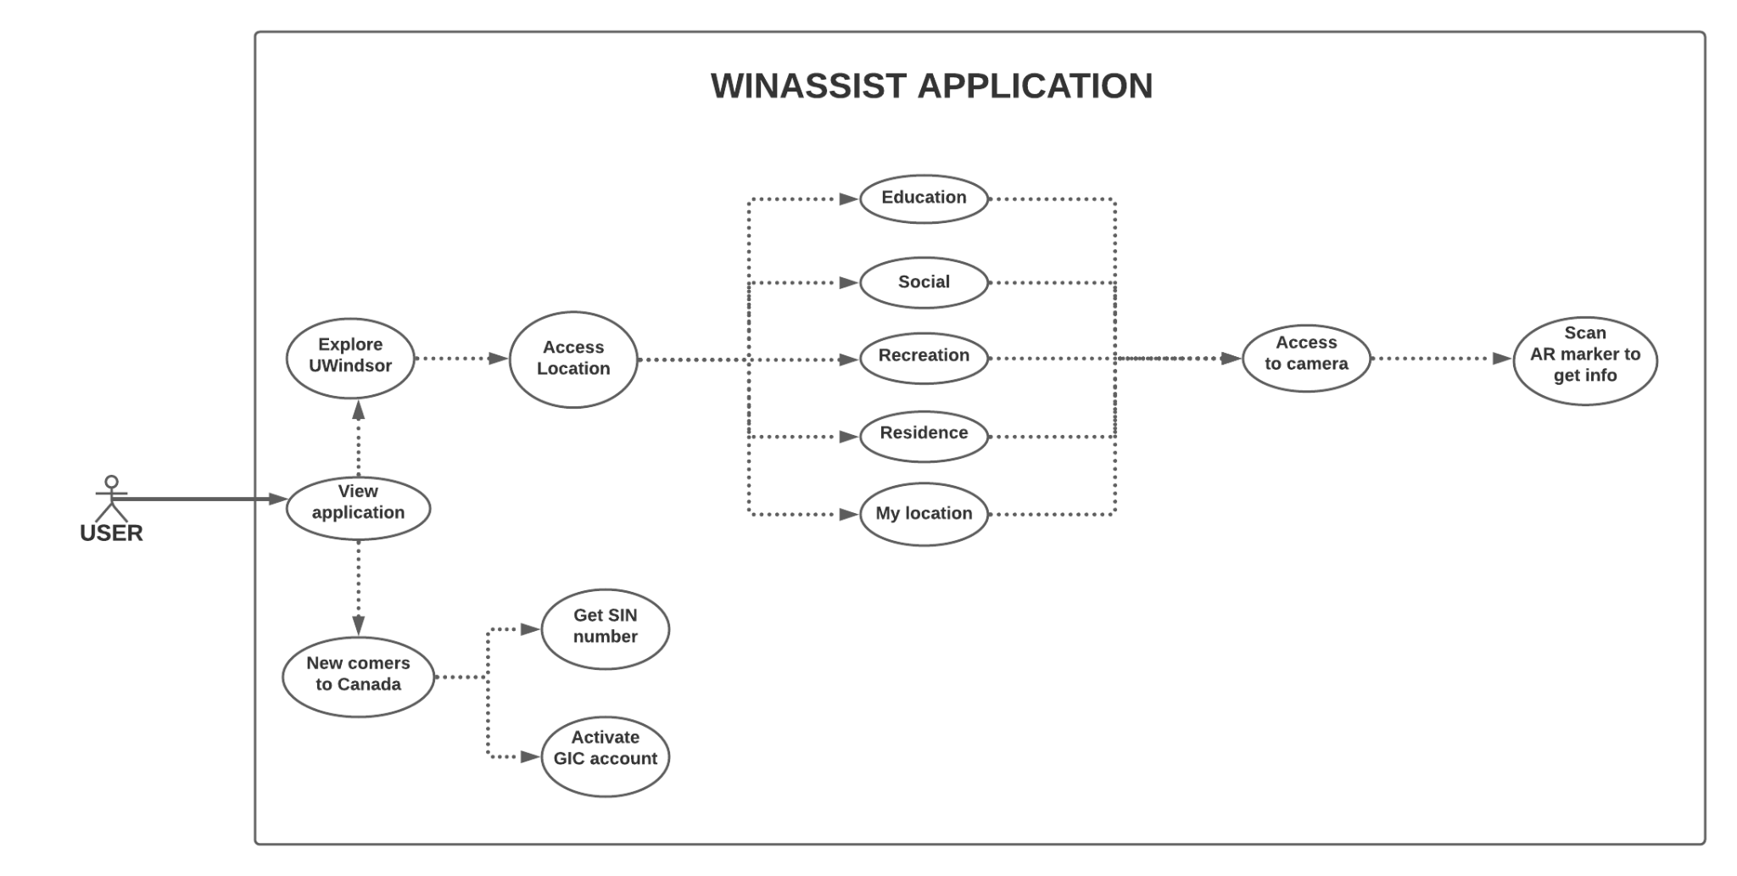
WINASSIST - Use Case Model

Slide 12

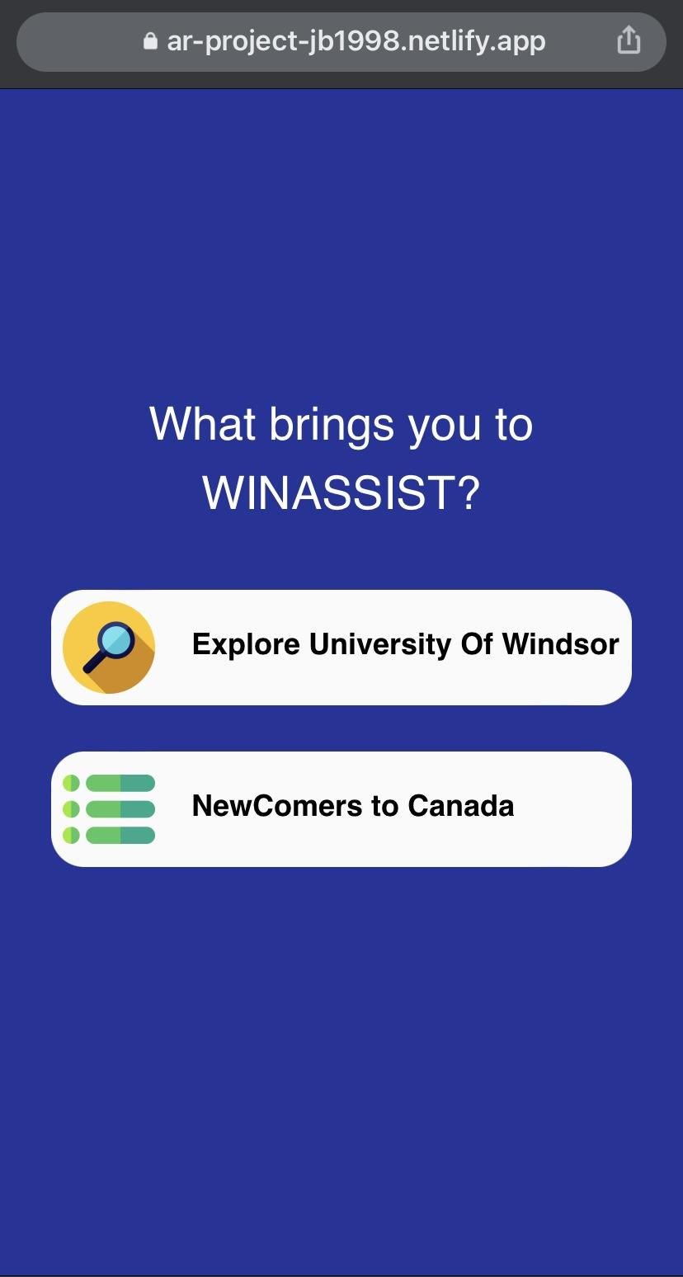
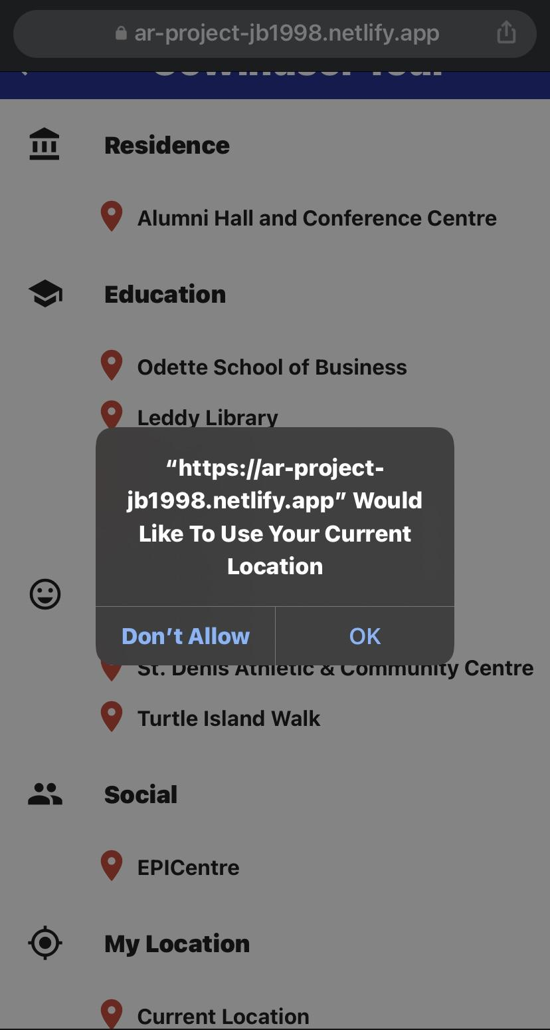
WINASSIST - Demo
Splash Screen
Main Screen
Access Location Alert

Slide 13
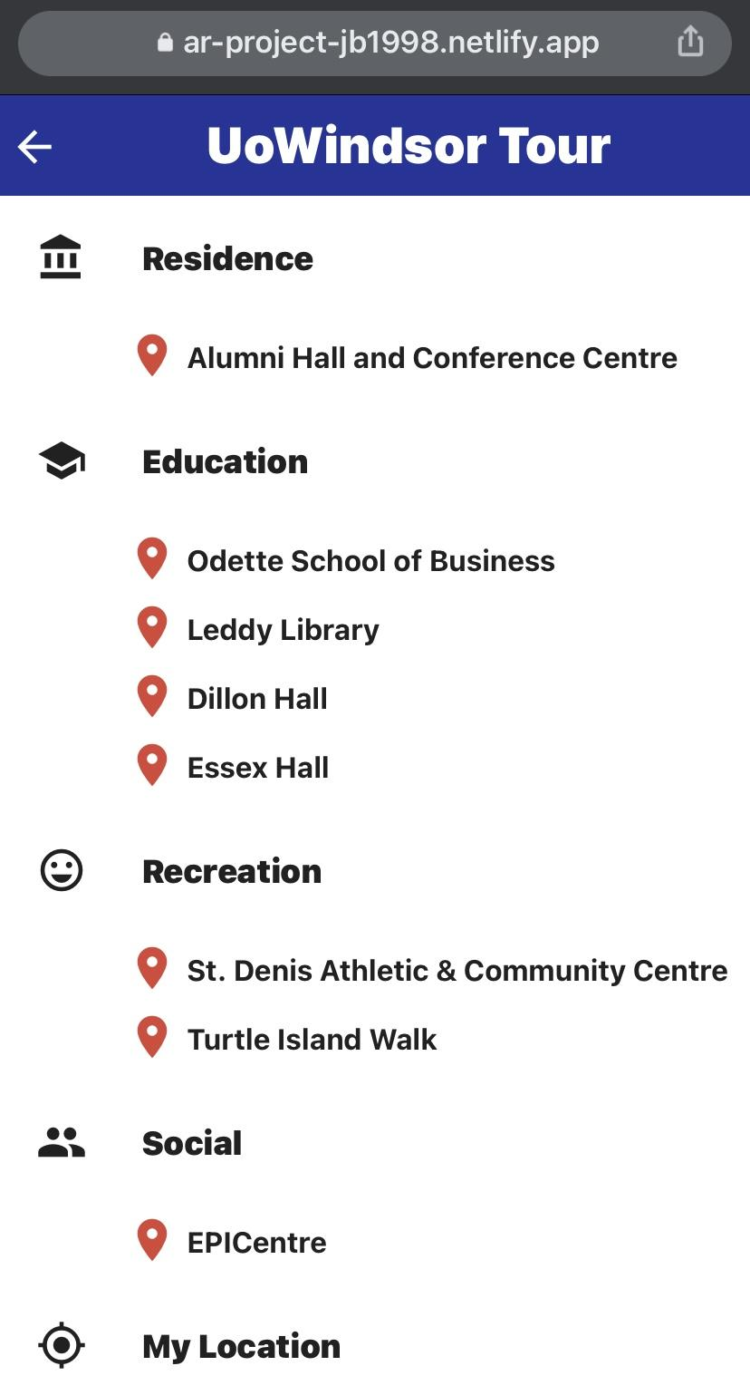
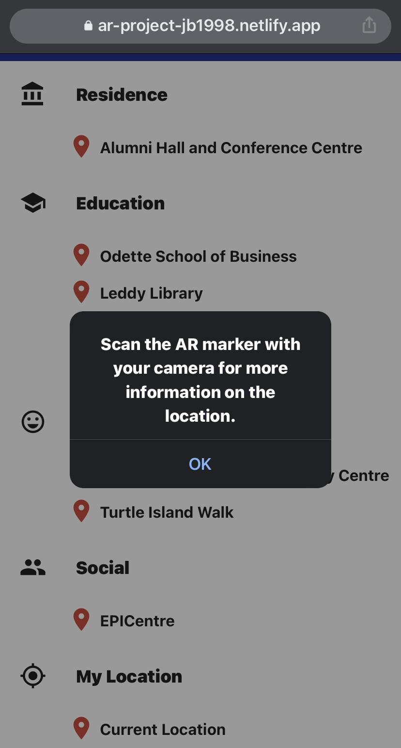
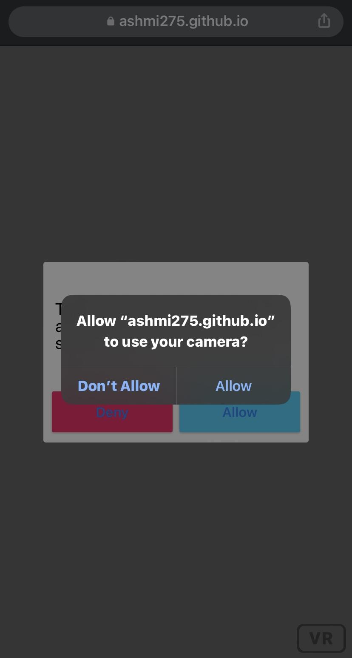
WINASSIST - Demo
University Tour Screen
Scan Marker Alert
Camera Access

Slide 14
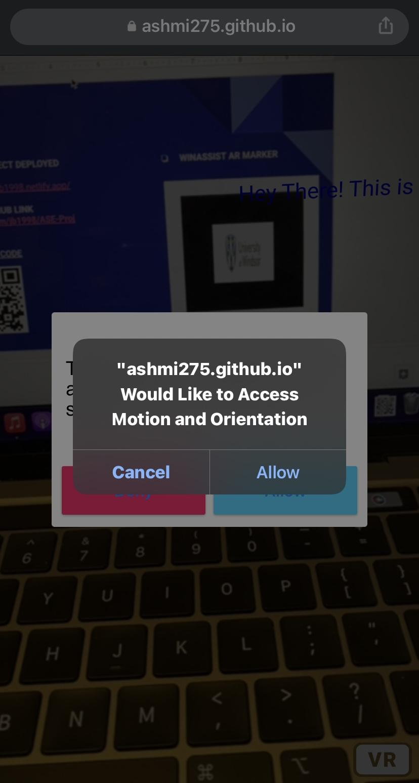
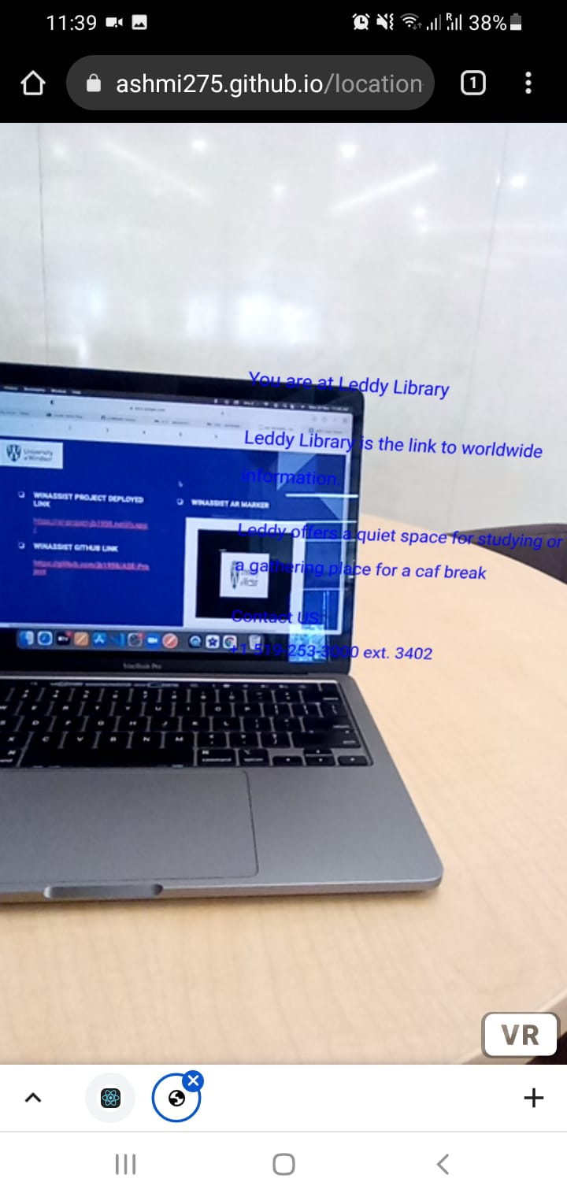
WINASSIST - Demo
Orientation Access
AR Screen

Slide 15
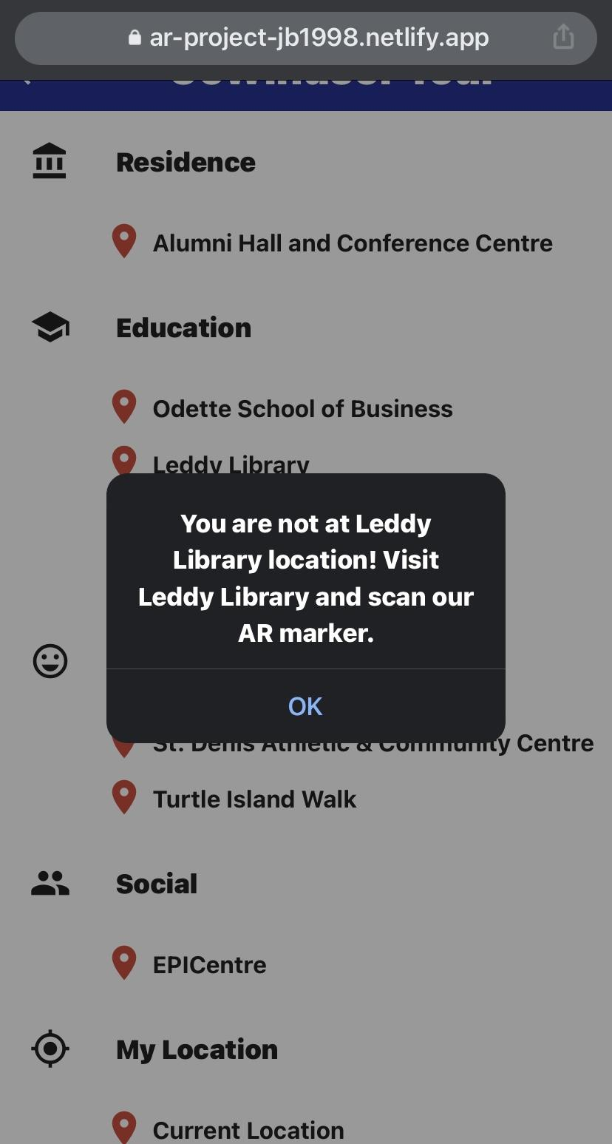
WINASSIST - Demo
University Tour Screen
Alert when location does not match

Slide 16
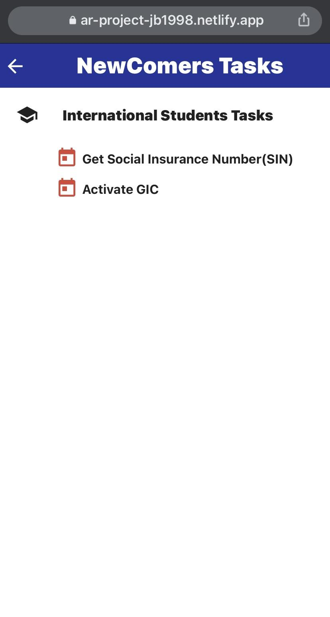
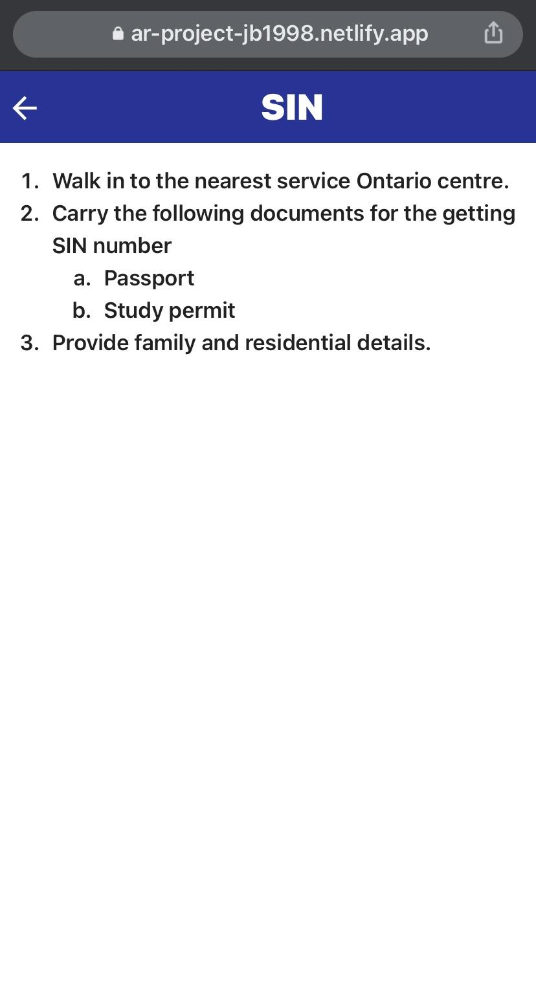
WINASSIST - Demo
Main Screen
Tasks Screen
SIN Screen

Slide 17
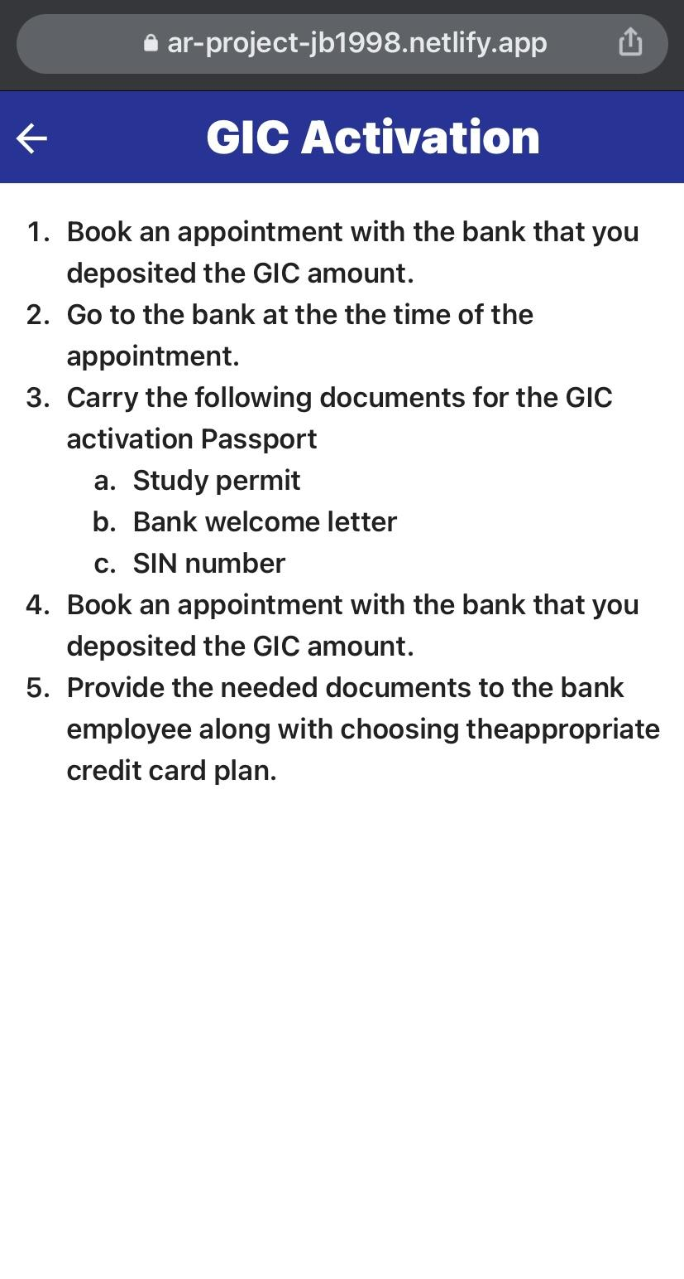
WINASSIST - Demo
Tasks Screen
GIC Screen

Slide 18

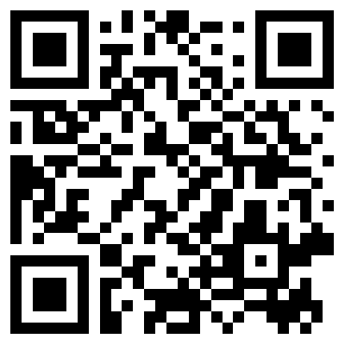
WINASSIST
WINASSIST PROJECT DEPLOYED LINK https://ar-project-jb1998.netlify.app/
WINASSIST GITHUB LINK https://github.com/jb1998/ASE-Project
WINASSIST QR CODE
WINASSIST AR MARKER

Slide 19
WINASSIST: Testing
Unit testing - Each feature was tested individually to make sure expected output is present.
Integration testing - All the features were tested together to make sure they work properly and then all the features were merged together in Github.
Alpha testing - The developers did the alpha testing of the product based on all the possible scenarios.
Beta testing - Beta testing was performed individually by the design team, RnD team and few other friends at various places like the scotia bank, leddy library etc.

Slide 20
WINASSIST : FUTURE SCOPE
Deploy the app on amazon web server to serve the large audience and expand it from windsor tour to Canada tour
We wish to extend it for universities games like the Treasure hunts where hints would be given based on AR scanning.
The application runs in React on Frontend and there is no backend as of now. We plan to use Firebase/MongoDB to make the backend to store data and provide more customised user experience.
We wish to make the design even better by including animations and multiple components in UX for better user experience

Slide 21

WINASSIST : SUMMARY
This project provides insights into working of the AR based windsor tour application developed in React JS.
The software development processes and efficient tools like the Jira, Github, Microsoft Teams apps etc. were used to manage the project and for communication within the team.
The proposed app gives description of the location if the user is present at that location based on AR technology.
To further optimise the app and provide better user experience multiple dialog boxes were implemented in the app.
The app is deployed and can used by anyone on any mobile device using the link.
[5]

Slide 22
REFERENCES
[1] “Gui, content Free Icon of LibreICONS Black.” Icon-Icons, https://icon-icons.com/icon/gui-content/158492.
[2] “Roles And Responsibility Icon , Png Download - Duties And Responsibility Icon, Transparent Png , Transparent Png Image.” PNGitem, https://www.pngitem.com/middle/ibTwobh_roles-and-responsibility-icon-png-download-duties-and/
[3] Digite. “What Is Scrum Methodology? & Scrum Project Management.” Digite, https://www.digite.com/agile/scrum-methodology/#scrum-process
[4] “Feature timeline and Epic Roadmap.” Visual Studio Marketplace, 14 October 2019, https://marketplace.visualstudio.com/items?itemName=ms-devlabs.workitem-feature-timeline-extension.
[5] “Summary Icon Stock Illustrations – 5,636 Summary Icon Stock Illustrations, Vectors & Clipart.” Dreamstime.com, https://www.dreamstime.com/illustration/summary-icon.html.

Slide 23
THANK YOU

